Slide 1
Case Studies
November 2013
AMI, Distribution Automation, and Substation Automation

Slide 2
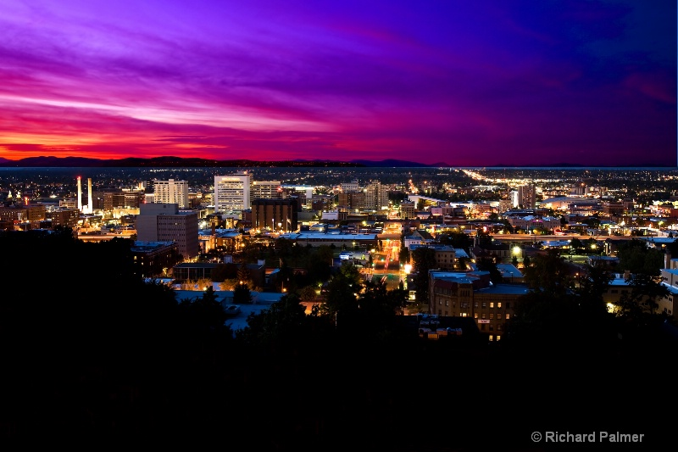
Avista

Slide 3
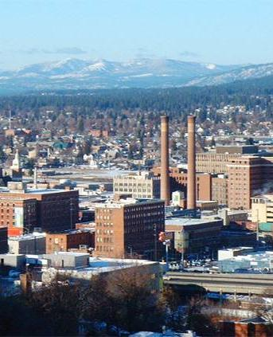
Avista
Two smart grid projects underway
Spokane Smart Circuits Project
Goal: reduce outage times through faster detection and isolation of faults
14 substations and 59 distribution feeders serving >110,000 customers
Network connects >200 DA devices
Pullman Smart Grid Demonstration Project
AMI: 13,000 power and 5,000 gas meters
DA: 13 feeders and >60 DA devices (reclosers, cap banks, transformers)
Part of the Pacific Northwest smart grid demonstration project
Opportunity to extend use of networks for additional applications

Slide 4
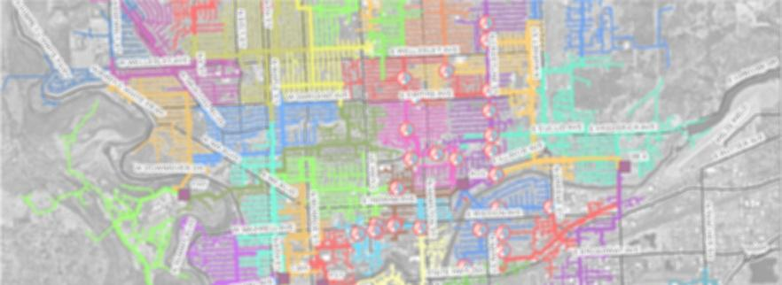
Spokane Smart Circuits Project
Scope and goals
Scope
14 substations
59 distribution feeders
>110,000 customers
Goals
Increased reliability
Reduce energy losses
Integration of distributed energy resources
Extend life of assets
Source: Avista

Slide 5
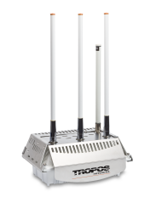
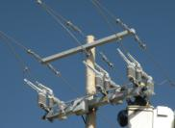
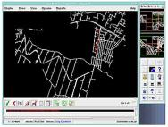
Smart grid enabling technologies
Communications
Wireless to field devices
Fiber to the substations
Distribution equipment
Switches and reclosers
Capacitor banks
Regulators
Control software
Remotely control and operate distribution equipment
Continually analyze the system for optimization
Source: Avista

Slide 6
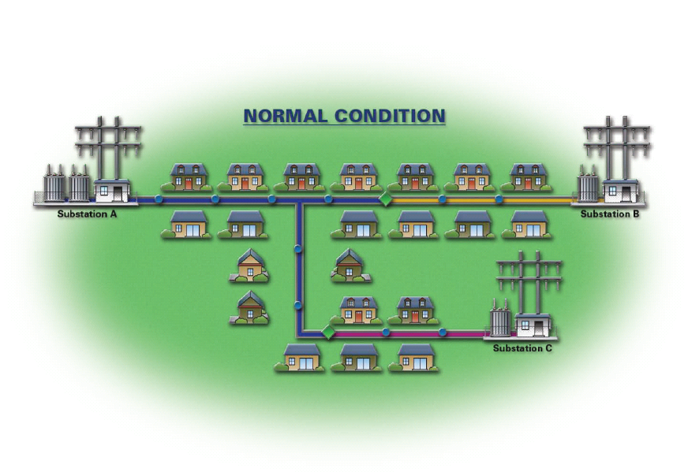
Outage restoration example
All customers have power
Source: Avista

Slide 7
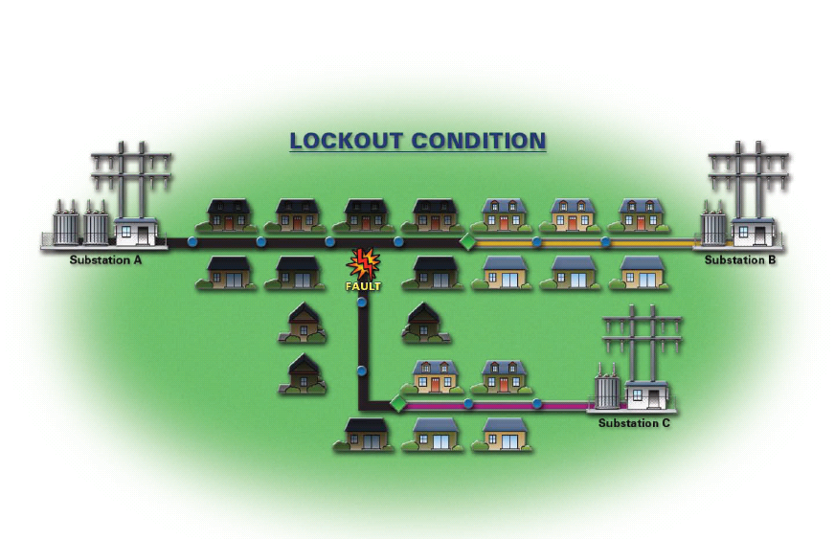
Outage restoration example
Customers between Substation A and tie points lose power
Source: Avista

Slide 8
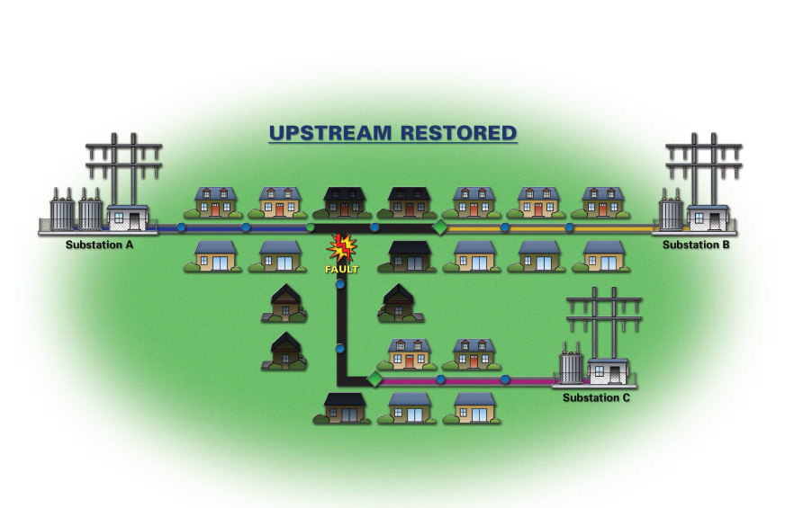
Outage restoration example
Power restored from Substation A to switch nearest fault
Source: Avista

Slide 9
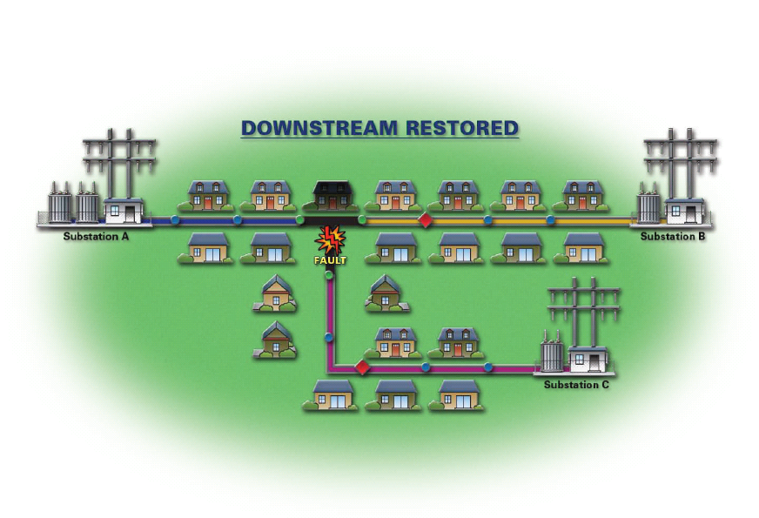
Outage restoration example
Power restored from Substations B and C to switches nearest fault
Source: Avista

Slide 10
Spokane Smart Circuits Project
Energy efficient benefits
120V
114V
126V
120V
114V
126V
Switched capacitors reduce conductor losses
Voltage optimization/CVR
Carbon reduction: 14,360 tons per year
$50/ton to sequester
$718,000/year

Slide 11
Pullman Regional Demonstration Project
Focused on many aspects of smart grid
Enable active participation by customers through home automation/demand response
Automated meters
In-home control
Home automation
Accommodate many generation and storage options
Wind integration/control
Battery backup
Automated control
Workforce development via smart grid class at Washington State University

Slide 12
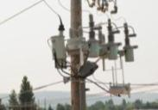
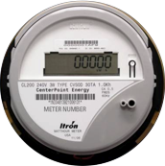
Pullman Regional Demonstration Project
Feeder and metering automation
Switching
Devices remotely operable
Conservation voltage reduction
Optimal switching flow
Voltage management
Devices include voltage and current sensing
DMS simulates loads
Active Volt/VAR management
Itron OpenWay electric and gas meters
Five minute electric interval reads
Daily gas reads
Source: Avista

Slide 13
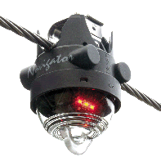
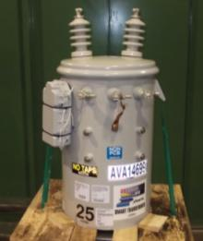
Pullman Regional Demonstration Project
Enhanced automation devices
Faulted circuit indicators – enhanced fault localization
Smart transformers – transformer loading information
Source: Avista

Slide 14
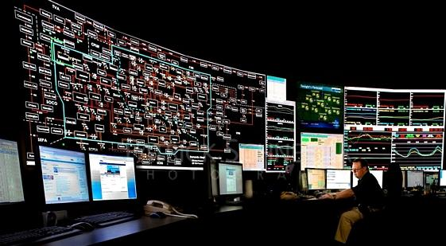
Pullman Regional Demonstration Project
Real-time monitoring of distribution circuit loading
Source: Avista

Slide 15
Tropos opportunity summary
Avista Spokane and Pullman
Spokane Smart Circuits Project
450 routers
Partner: none – Tropos direct
Pullman Regional Demonstration Project
100 in Itron-branded routers
100 Tropos 1410-B bridges integrated in transformers
Partners: Itron, Howard
Potential to expand to other portions of Avista’s service area
Notes:
$84M ARRA grant from DOE; DTE matched this to make it a $168M project
Tropos network to be installed by July 2011 and replacing cellular network that is providing backhaul for 250,000 OpenWay smart meters today. Reason for replacing cellular: reliability issues. With Tropos can run multiple smart grid applications.
Rollout of phase I has started and must be completed by mid-2012

Slide 16

Detroit Edison

Slide 17
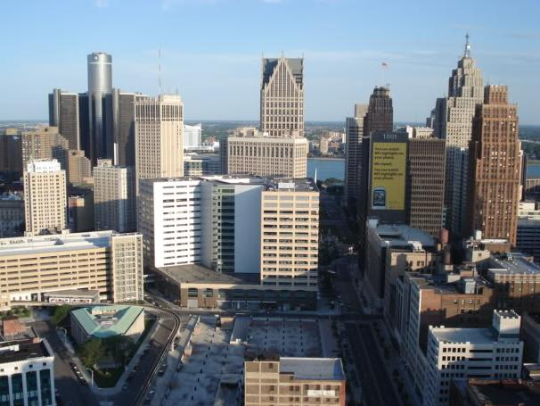
DTE Energy Initially AMI Backhaul – Now Expanding Applications
Customer: DTE Energy
Customer need
Replace/augment unreliable cellular network
ABB response
AMI backhaul for 1,200,000 power meters
Communications to 200+ DA devices
Tropos added IPsec VPN capabilities to products to meet specific DTE needs
Opportunity to leverage Tropos network for
Smart gas meter backhaul
Mobile utility workforce applications
Customer benefits
High throughput, low latency network
Average 1.25 Mbps throughput/7.4 msec latency to AMI collectors
Average 3.16 Mbps throughput/ 6.2 msec latency to DA endpoints
Exceeded target meter read success rate
Transmission
Distribution
In Plant Communication
Smart Grids
Railways
Oil & Gas
Heavy Industries
Mines
Smart Cities
“We selected the Tropos mesh as it has the capacity and security to support AMI, distribution automation, mobile workforce automation and other smart grid applications.”
Brian Moccia AMI Technology Manager DTE Energy
Notes:
DTE selected Tropos to provide backhaul for AMI after having issues with the cellular network providing reliable connectivity.
They quickly realized that Tropos could help them also deliver their DA communications effectively to over 180 devices covering 25% of their customers, and they could leverage the system for other applications including mobile workforce applications.
The product capability and flexibility impressed DTE’s project team, but our dedication to their needs have earned their trust and they consistently highlight the Tropos solution in their presentations on their project.

Slide 18
Substation Automation Applications

Slide 19

Wireless in substations
What’s the business case?
Wireless not generally consider to be a great fit for substations
If building a new substation, most likely going to put fiber in the ground (or cable trays)
Wireless networks serving feeders might terminate at fiber switch ports in substation but few other uses
Game changer – the need for utilities to retrofit existing substations with automation capabilities

Slide 20
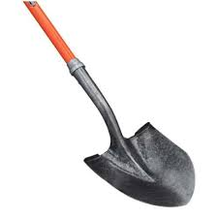
Main factor driving wireless in substations
Desire to avoid trenching in substation yards
However as utilities look to add automation to existing substations, wired connections are not as readily available as many had assumed
Going back and deploying fiber or fiber trays within existing substations is an expensive proposition
Trenching costs
Drilling holes in control cabinets
Safety considerations
For substation retrofits, wireless is a great fit

Slide 21
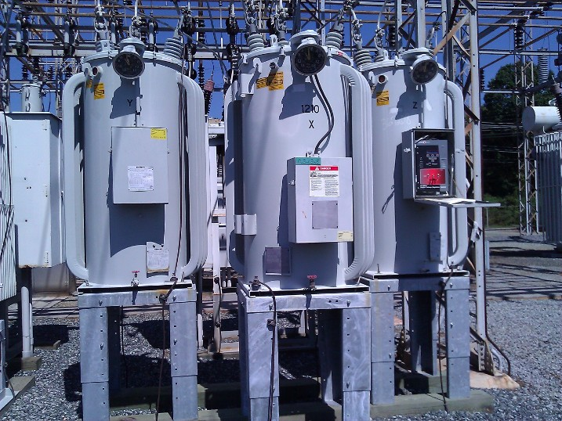
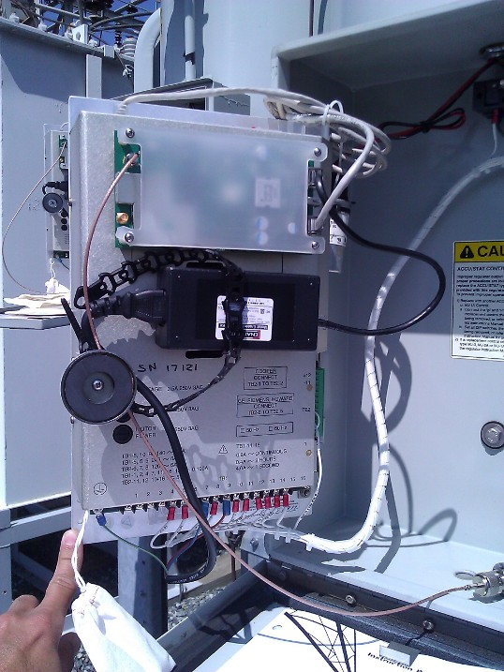
Example #1
Substation automation with integrated communications
Starting automate substations with SCADA (specifically voltage regulators)
Communication requirements
Access to control panels without pulling any communications cables
No holes drilled in regulator cabinets as this would increase both installation time and costs
Access to controls from anywhere within the substation
Check or change settings, update firmware and control regulators from safe distance
Readily available monitoring, data logging, power quality, and condition-based maintenance information
Support for proper cyber security standards

Slide 22
Voltage regulator controller opportunity
Substation pilot architecture
~150 feet from regulators to control house
Tropos 1410 wireless bridges installed in each regulator cabinet
Antennas were selected to provide enough signal strength when mounted inside the cabinets
Throughput still more than 1 Mbps
Output of radios configured so that it’s strong to operate within the substation, but is not visible outside the fence
SSID of network is hidden
Ethernet used to connect regulator controllers and Tropos wireless bridges
Wireless bridges communicate to a Tropos wireless gateway mounted outside the control house
Gateway connects to Layer 2 switch in the control house via Ethernet
Layer 2 switch also connects to an automation control unit
L2 switch provides optical isolation and allows other devices in substation access to wireless network and substation computer
Protocol used is DNP3 over TCP/IP
Can also access individual controls over the wireless network
Notes:
Tropos has networks aggregating close to 300,000 meters today and that number is continuing to grow as customers rollout smart metering networks.
22

Slide 23
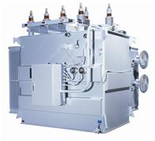
Example #2
Substation transformer gas monitor sensors
Utility had gas monitors that they require readings from a few times a day
Doing lifecycle monitoring and management as lead time on replacement transformers is approximately two years
The substation itself has fiber connectivity (backhaul) but the utility stated it was too difficult and too expensive to install fiber within the substation yard
Previously each gas monitor was connected via a Sierra Wireless cellular modem
Field communications manager wanted to reduce cellular communication costs
For the pilot, cellular cards with a Tropos 1410 which connect to a gateway at the control house
Still backhauling via cellular out of the substation
Cut cell modem requirement, reducing operating expenses

Slide 24
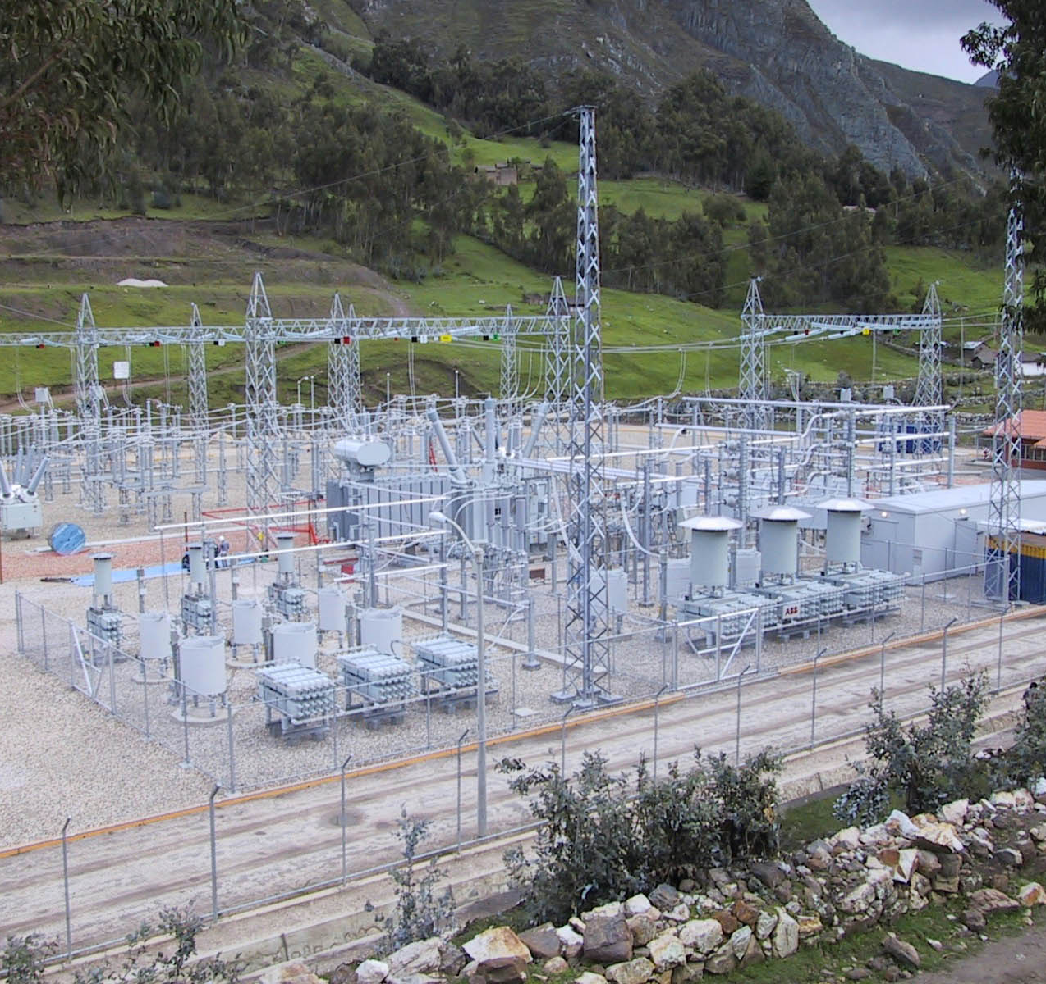
Substation wireless enables applications beyond automation
Security applications can use the wireless network to support video surveillance cameras and intrusion sensors
Transformer monitoring via the wireless network using smart transformers or gas sensors mounted near conventional transformers
Mobile workforce applications enabled by connecting field workers’ laptops, tablets and handhelds to the substation’s wireless network

